Slide 1
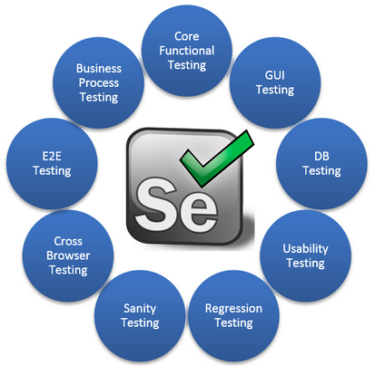
Automation Testing

Slide 2
Automation Testing v/s Manual Testing
The method that takes automation tool support to execute the test cases is known as Automation Testing. Automated testing is good for large project.
Manual testing is a method used by software developers to run tests manually.

Slide 3
Selenium
Selenium is a popular open-source web-based automation tool.
Selenium is a free (open source) automated testing suite for web applications across different browsers and platforms.
Selenium is not just a single tool but a suite of software's, each catering to different testing needs of an organization.

Slide 4




Who developed Selenium?
Primarily, Selenium was created by Jason Huggins, engineer at ThoughtWorks in 2004.
Selenium RC – Paul Hammant
Selenium Grid – Patrick Lightbody
Selenium WebDriver – Simon Stewart

Slide 5
The 4 components
Selenium Integrated Development Environment (IDE)
Selenium Remote Control (RC)
WebDriver
Selenium Grid

Slide 6
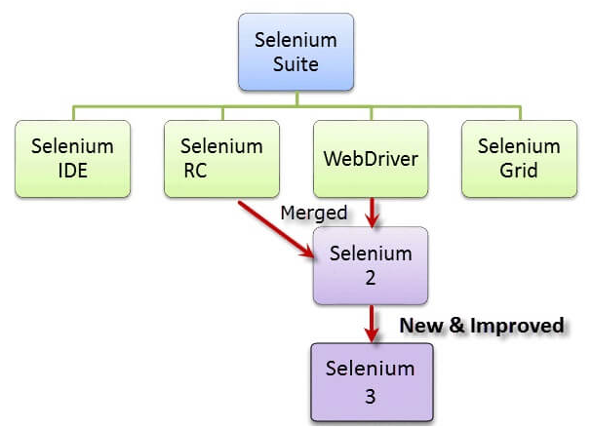
The 4 components

Slide 7
The 4 components
Selenium IDE - Open source record and playback test automation for the web
Selenium Remote Control (RC) is a test tool that allows you to write automated web application UI tests in any programming language against any HTTP website using any mainstream JavaScript-enabled browser.

Slide 8
The 4 components
Selenium WebDriver is a compact Object Oriented API and is the name of the key interface against which tests should be written in Java.
Selenium Grid is a part of the Selenium Suite that specializes in running multiple tests across different browsers, operating systems, and machines in parallel.

Slide 9
Automation Testing Tools
Gauge – open-source | Appium
Cypress – open-source | Robotium
TestComplete | Micro Focus UFT
QMetry Automation Studio | Micro Focus QC
IBM Rational Functional Tester | Test Studio
LambdaTest | Cucumber
Qualibrate | EggPlant
Testsigma | SilkTest

Slide 10
Why choose Selenium IDE
Exporting test cases in various formats.
To create tests with little or no prior knowledge in programming.
To create simple test cases and test suites that you can export later to RC or WebDriver.
To test a web application against Firefox only.

Slide 11
Tools Required
jdk[1.8]
Eclipse[Mars, Neon, Oxygen]
Selenium jar file
Driver executable files
Latest version of browsers
Application Under Testing

Slide 12
The Seven Basic Steps of Selenium Tests
1. Create a WebDriver instance.
2. Navigate to a Web page.
3. Locate an HTML element on the Web page.
4. Perform an action on an HTML element.
5. Anticipate the browser response to the action.
6. Run tests and record test results.
7. Conclude the test.

Slide 13
Advantages
It’s a freely available automation tool. We can download it from following website.
URL: http://www.selelniumhq.org/download
It’s an open source tool. We can see the source code of selenium from following website
URL: https://github.com/SeleniumHQ/selenium
Using selenium we can automate only web based applications.
Ex:- gmail, facebook, flipkart etc,
Selenium supports for 14 programming languages
Selenium provides support for multiple platforms such as Windows, Mac and linux.
Selenium supports multiple browsers such as google chrome, mozilla firefox, internet explorer, safari etc.

Slide 14
Steps to install Selenium
Download selenium jar file and driver exe files from following website.
URL - http://www.seleniumhq.org/download
Extract all the driver exe files
In eclipse, create a java project with the name Automation.
Under the Java project create 2 folders with the name drivers and jars
To create folder, Right click on project→new→create folder
Store all extracted driver exe files under drivers folder
Store selenium jar file under jars folder
Associate selenium jar file with java project
To associate the jar file, right click on jar file→Build path→Add to build path

Slide 15
BROWSER SUPPORT
To perform action on chrome browser, webdriver will communicate with chromedriver.exe
To perform action on firefox browser, webdriver will communicate with geckodriver.exe
To perform action on ie browser, webdriver will communicate with IEDriverServer.exe

Slide 16
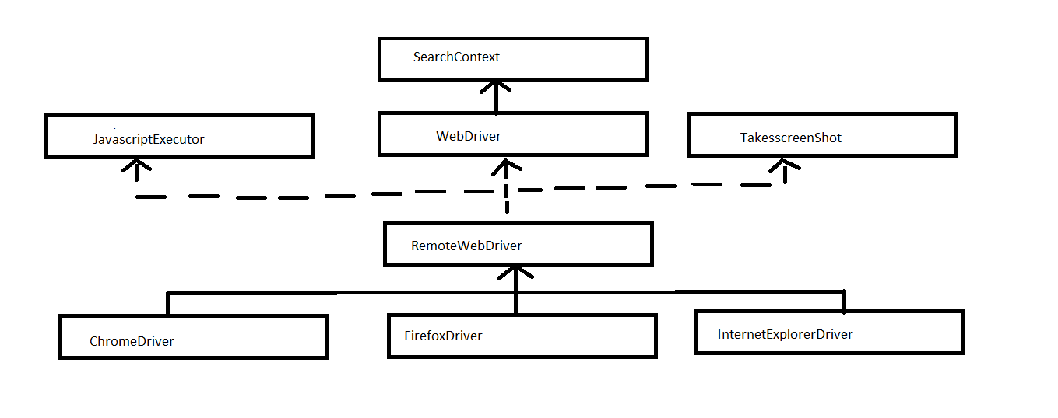
Java Selenium High-level Architecture

Slide 17
WebDriver Interface Methods
get()
getTitle()
getCurrentUrl()
getPageSource()
findElement()
findElements()
getWindowHandle()
getWindowHandles()
switchTo()
manage()
navigate()
close()
quit()

Slide 18
JavaScriptExecutor Interface methods
executeScript()
executeAsyncScript()

Slide 19
TakeScreenShot Interface method
getScreenShotAs()

Slide 20
Importing packages
org.openqa.selenium.*- contains the WebDriver class needed to instantiate a new browser loaded with a specific driver
org.openqa.selenium.firefox.FirefoxDriver - contains the FirefoxDriver class needed to instantiate a Firefox-specific driver onto the browser instantiated by the WebDriver class

Slide 21
Instantiate objects and variables
WebDriver driver = new FireFoxDriver();

Slide 22
Launch the browser session
WebDriver's get() method is used to launch a new browser session and directs it to the URL that you specify as its parameter.
driver.get(baseURL);

Slide 23
Terminating the browser session
The "close()" method is used to close the browser window.
driver.close();

Slide 24
Pre-requisite
System.setProperty("webdriver.chrome.driver","./drivers/chromedriver");
WebDriver driver = new ChromeDriver();

Slide 25
Locating HTML Elements on a Web Page
Before performing action on any elements on a web page, we have to perform following steps.
Inspect the element
Identify/locate the element
Find the element
Perform the action

Slide 26
Selenium Locators
Locators are static methods which are used to identify the elements present on a webpage.
All these locators are present in a class called By which is an Abstract class.
There are 8 types of locators and all the locators takes argument of type string.

Slide 27
Selenium Locators
8 types of Locators include -
Id(String)
name(String)
className(String)
tagName(String)
linkText(String)
partialLinkText(String)
cssSelector(String)
xpath(String)

Slide 28

ID to Select the Element
It is a unique reference for a web object that the developer sets while writing the code.
It is preferable to have a unique id, so it is unlikely to meet similar values.
Feasible for elements with fixed IDs but not for the generated ones.

Slide 29

Name to Select the Matching Element
Every form has input fields with unique names. Names are unique most of the times, but it’s not a restriction.
However, a field name locator is the best choice for testing a login form.
It is more appropriate to use it when you have a list of similar types of elements.
Using it with a dynamically generated list is tough.

Slide 30

ClassName to select the Element
The CSS class locator uses a specific class attribute to get to the first element on a web page.
It is useful for items that own a unique style.

Slide 31
Tag Name to Find the Element
The element name/tag name is used to locate the element on the webpage.
Ex:
List <WebElement> list = driver.findElements(By.tagName("a"));
System.out.println("Number of links: "+list.size());

Slide 32

Link Text to Select the Link Element
It is a perfect way to find the links on a page.
It’ll only work for anchor tags.
Use it for checking navigation flows.
You need to provide the link text for it to work.

Slide 33

Partial Link Text to Select Link Element
It is very similar to Link Text Locator.
In some situations, we may need to find links by a portion of the text in a Link Text element. it contains.
Differs in the way you use it to find the element.

Slide 34
CSS Selector to Access the Elements
CSS Selectors are no different than the Xpaths.
They are resilient and robust.
Unlike the XPath, they aren’t dependent on the DOM structure.
They can help you perform actions that are difficult to do with XPath.

Slide 35

Relatively speedier than using the XPath.
Its usage is growing as the web pages are getting more style-centric.
It’s easy to define a unique CSS locator as you can combine multiple CSS attributes.
It’s not easy to form a CSS selector and requires a deeper understanding of the CSS/Javascript.

Slide 36
Note:
In cssSelector,
Id can be represented by using #,
Ex:- input#email
Class can be represented by using .
Ex:- tagName.classValue

Slide 37
XPath to locate Elements
It is a perfect technique for walking through the DOM structure of the web page.
XPath locators are robust and reliable.
It is one method which guarantees to locate any element on the page using the XPath expression.
But you should be very careful while forming an XPath as it may not work if there are changes in the web application.

Slide 38

Absolute XPath:
It starts from the root element within the web page or part of the page and goes to identify the target element.

Slide 39

Relative Xpath
The relative XPath are easy to manage as they are short and concise. It is also better than the previous XPath style as it may survive the changes in the Page HTML to a certain degree.

Slide 40
Syntax
//tagName---> all matching elements
//tagName[1]--> all the 1st matching elements
//tagName[2]---> all the 2nd matching elements
//tagName[last()]--- all the last matching elements
//*--- all the elements present in the web page

Slide 41
Xpath by attribute
In order to identify specified elements, it may not work properly when we use the index because, whenever the position of the elements changes, it’s index value will also changes.
To over come the above problem we use xpath by attribute.
It is applicable for both absolute and relative xpath.
Syntax:
tagName[@attributeName='attributeValue']
Ex:
Absolute--- /html/body/div/input[@value='B']
Relative--- //input[@value='B']

Slide 42
Xpath by text()
If the specified element does not contain any attribute and if it contains text, then we can identify that element by using xpath by text.
Anything which is present in between opening and closing tag.
It is applicable for both absolute xpath and relative xpath.
Syntax: tagName[text()='textValue']
Ex:- //td[text()='Java']

Slide 43
XPath to locate Elements
Guarantees to find accurate locators.
It is slow as compared to CSS.
It’s browser dependent, and there are differences in IE vs. Firefox XPath implementations.
Building a relative XPath is time-consuming and quite tricky as you need to check all the nodes to form the path.

Slide 44
Collections
Group of individual objects treated as a single entity is called a Collection.
Ex: List, Queue, Set etc.,
The Collection in Java is a framework that provides an architecture to store and manipulate the group of objects.
Ex: JavaDemo.java

Slide 45
List
List is an interface which is implemented by the classes, ArrayList, LinkedList and Vector
List allows duplicates.
List allows null values.
In List insertion order is preserved.
List is an index based

Slide 46
List
In List ,
we can add the data using add()
get the size using size()
get the data using get()
Note: Return type of get() depends on type of data which are stored in List.

Slide 47
Handling Multiple Elements
In order to handle multiple elements we use findElements().
Return type of findElements() is List<WebElement>.
In findElements() if the specified locator is matching with multiple elements, it returns address of all the matching elements
In findElements() if the specified locator is not matching with multiple elements, it returns empty list(0)

Slide 48
Handling Multiple Elements
Ex:Create a webpage checkboxsample.html
To count number of check boxes present in the webpage - CountCheckbox.java
NOTE:
For findElements(), the preferred locators are,
tagName
xpath

Slide 49
Handling drop-down list or list box
If the list box is developed by using select tag then we can handle it by using Select class.
Select class should be imported from the package org.openqa.selenium.support.ui
Select class contains one constructor which takes an argument of type WebElement where in we have to pass address of the list box.

Slide 50
Select class methods for selecting the options.
selectByIndex(int)
selectByValue(String)
selectByVisibleText(String)

Slide 51
Select class methods for deselecting the options
deselectByIndex(int)
deselectByValue(String)
deselectByVisibleText(String)
deselectAll()

Slide 52
Get the options from listbox.
getAllSelectedOptions()
getFirstSelectedOption()
getOptions()
isMultiple() - check whether the list box is single/multi select list box

Slide 53
Handling drop-down list or list box
Ex listbox.html
WAS to select by index, select by value and select by visible text.
Enhance to de-select the same.
Count and print all the selected options

Slide 54
Actions
Actions is a class which implements Action interface.
Actions class is used to perform mouse and keyboard actions.
Actions class contains a constructor which takes an argument of type WebDriver.
When we are using any methods of Actions class it is mandatory to call perform(). Otherwise Actions class will not perform the actions.

Slide 55
Handling Drop-down menus
We can handle drop down menu by using moveToElement() of Actions class.
moveToElement() takes an argument of type WebElement where in we have to pass address of the element.
moveToElement() will virtually move the cursor to specified element.
Ex: RedBrick.java

Slide 56
Handling Drag and Drop Actions
We can handle drag and drop action using dragAndDrop() of Actions class.
It takes 2 arguments of type WebElement.
They are,
- Source
- Target
Ex: DragnDrop.java

Slide 57
Handling Double click Actions
We can handle double click action using doubleClick() of Actions class.
It takes 1 argument of type WebElement.
Ex: Create a sample web page, on double click of a button write a javascript to display “Welcome to PES” on the web page.
Then write a script to perform double click action and check the display of the message.

Slide 58
To Do
WAS to check whether the listbox is single-select or multi-select listbox.
WAS to print all the selected options from a listbox.

Slide 59
Context click
Right-clicking on an element is called context click.
What are context menus?
We can handle right click action by using contextClick() method of Actions class.

Slide 60
Synchronization
The process of matching the speed of selenium with the speedof application is called as Synchronization.
We can handle synchronization in two ways -
1) implicit wait
2) Thread.sleep()

Slide 61
Implicit Wait
It will handle the synchronization of findElement() and findElements().
implicitlyWait() takes 2 arguments of type long and TimeUnit.
In the 1st argument we have to specify waiting time and the 2nd argument we have to specify time unit
The different time units are
DAYS
HOURS
MINUTES
SECONDS
MILISECONDS
MICROSECONDS
NANOSECONDS

Slide 62
Workflow of Implicit Wait
When the control comes to findElement() or findElements(), it will check whether the element is present or not
If the element is present, it will return address of the specified element.
If the element is not present, it will check whether implicitlyWait() is specified or not.
If implicitlyWait() is not specified then it will throw NoSuchElementException or Empty list.
If implicitlyWait() is specified then it will check whether the specified time is over or not.

Slide 63
Workflow of Implicit wait
If the specified time is over then it will throw NoSuchElementException or Empty list.
If the specified time is not over then for every 500ms it will check whether the element is present or not.
Ex: ImplicitWaitDemo.java

